Slide 1



UNIT 1
LESSON 3
ALL THAT GLITTERS
Part 5

Slide 2
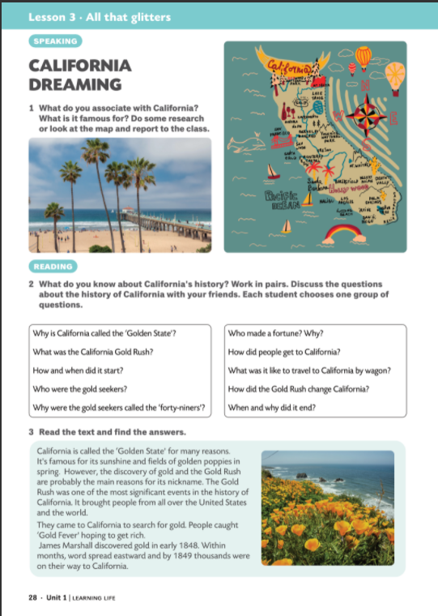


Slide 3
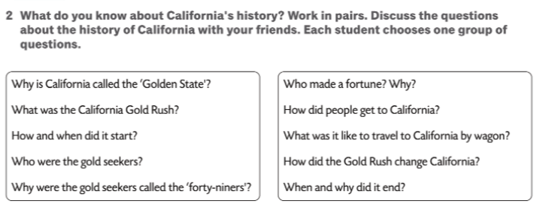
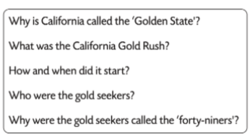
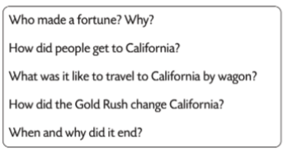

Slide 4
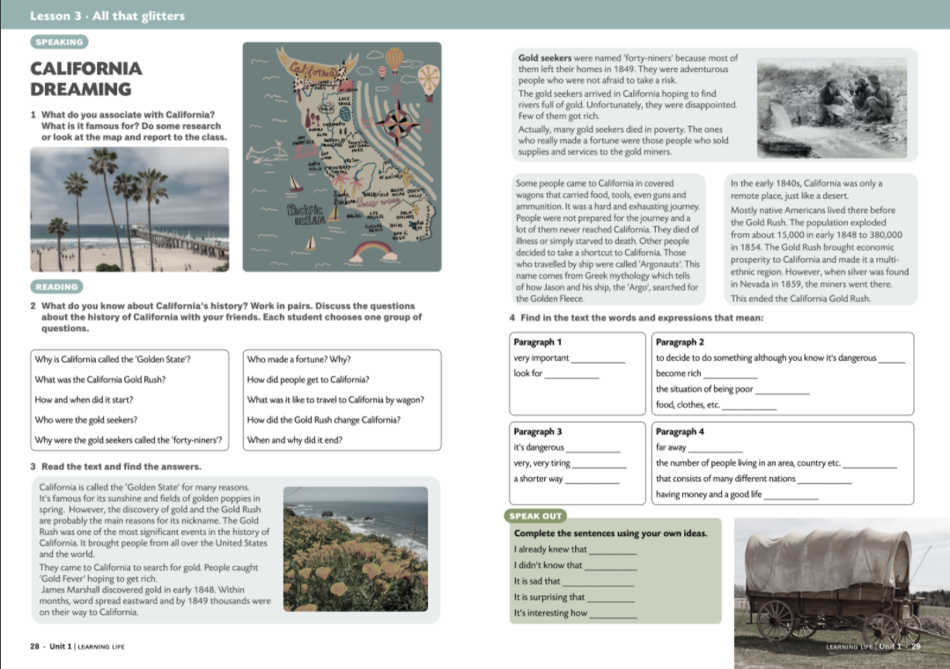
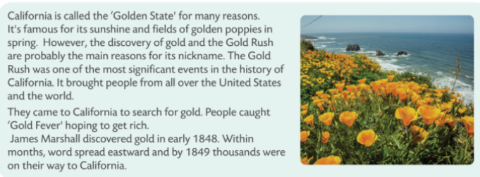

Slide 5
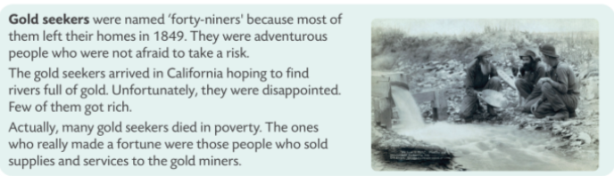
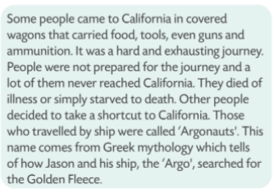
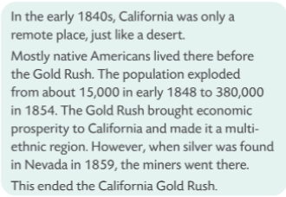

Slide 6
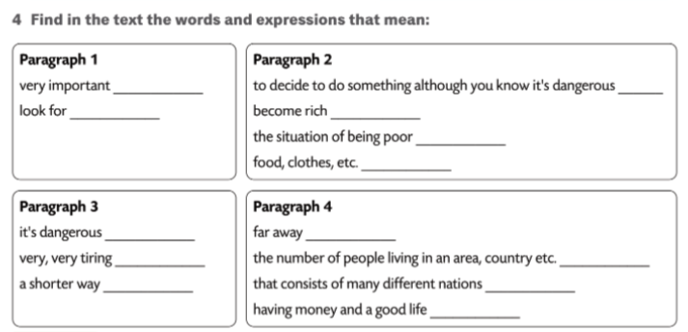
significant
take a risk
search
make a fortune
poverty
supplies
ammunition
remote
exhausting
population
shortcut
multiethnic
prosperity

Slide 7
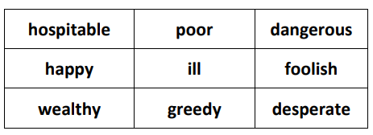
Play Noughts&Crosses with the words in the table.
You can first play the game with adjectives and nouns. Open the squares and try to come up with the nouns. The winners are those who first get three correct words in a row.
Play it again. You can play it with nouns and verbs, translations, gapped sentences, etc.

Slide 8
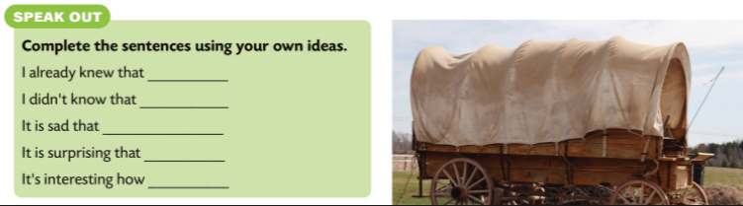
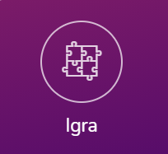
California (vocabulary)

